Slide 1
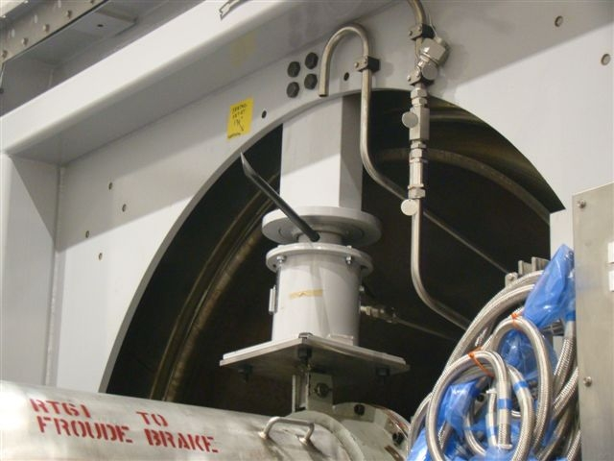
HS&E INCIDENT BULLETIN |  | 2nd Quarter 2013
U.S.A. | Type of incident Fall of Material
Summary:
While removing a bearing case support spring with a pry bar the individual lost his footing. The result was the pry bar falling from as the assembler went to catch himself. The pry bar then hit his co-worker in the left eye.
Root Causes: | Actions Taken Thus Far: Next Steps
Failure to maintain most current issue of tooling. Employee in the line of fire Failure to provide stable work platform | Restrict area around work space during this operation Review Spring location Review tooling used to perform the operation to create alternative for pry bar. Establish work platform minimum expectations
Pry Bar Inserted in spring to remove Coupling.

